Slide 1

Stock Prices and Finance Tweets Analysis
Lakshya Gupta Qingqing Hu

Slide 2
Content
Introduction
Dataset Description
Methodology
Results
Conclusion

Slide 3
Introduction
“In the long run, valuations may drive stock prices, but in the short term it is market sentiment that moves prices.”
Analysis of finance tweets and stock prices trend and performed different experiments to demonstrate the effect of different opinions available in tweets on the stock prices of companies like Amazon, Microsoft, Apple, AMD (Advanced Micro Devices) and Tesla

Slide 4
Dataset Description
Financial Tweets dataset from Kaggle
Stock Prices data from Yahoo Finance

Slide 5
Stock Prices
Financial Tweets
Company Name
Date
Closing price
Opening price
Adjusted price
Volume
Around 93k tweets
Published between April 9 and July 16, 2020
Using the SPX500 tag, the top 25 companies and ‘#stocks'

Slide 6
Methodology
Data Exploration and Preprocessing
Data Analysis

Slide 7

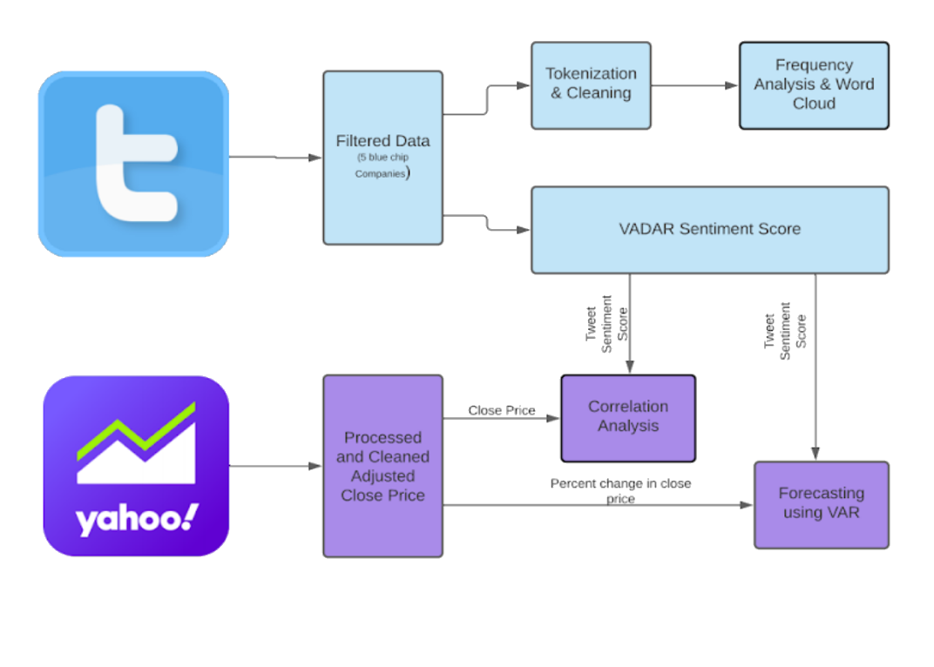

Slide 8
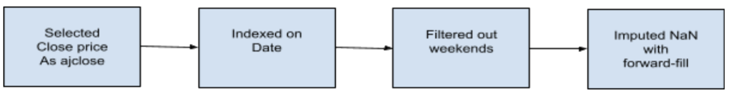
Stock Prices Data Preprocessing
Read data from Yahoo Finance using pandas_datareader.
Extracted data of weekdays
Fill the missing values using ffill method that replaces NaN values with the latest available price

Slide 9





Finance Tweets Data Preprocessing
Applied filter to get tweets of five desired companies
Used substring match of name and ticker of the company to map with their tweets
Created dataframe with filtered tweets

Slide 10
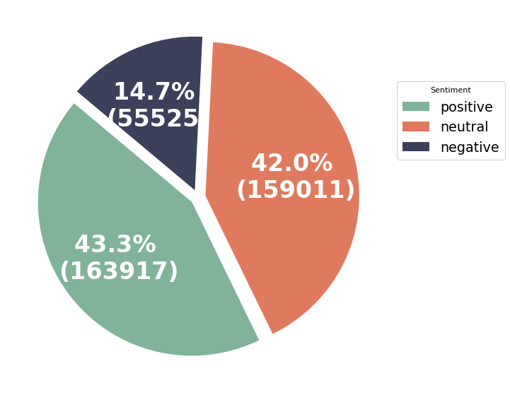
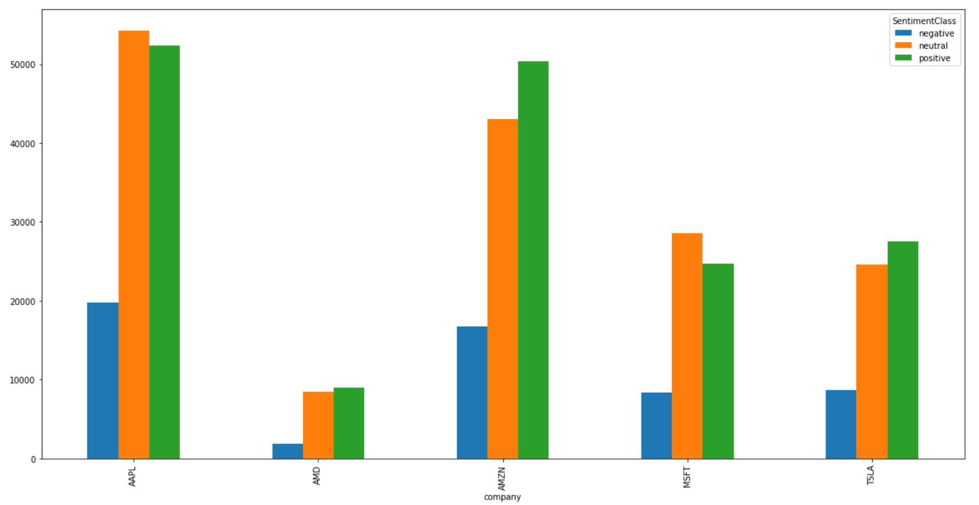
VADER Sentiment Analysis
Lexicon and rule-based analysis VADAR tool for Sentiment Analysis on filtered Finance Tweets data
Sentiment | Compound Score
Positive | 0.05 to 1
Negative | -1 to -0.05
Neutral | -0.05 to 0.05

Slide 11
Stock Price Data Analysis
Generated time series for the companies
Plots of trend in adjusted price of stock with date for each company
Trend in tweets sentiment scores for each company during this period
Plots of trend in average compound score of tweets and in stock prices of the companies to understand the correlation

Slide 12
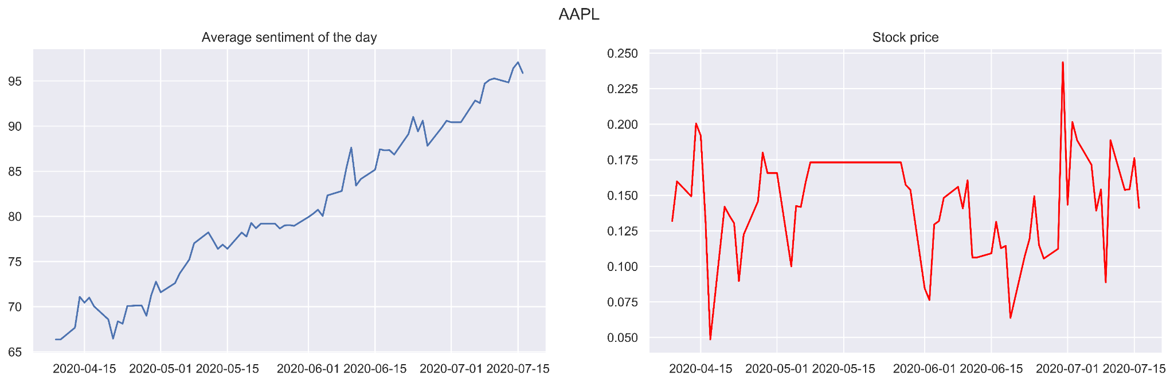
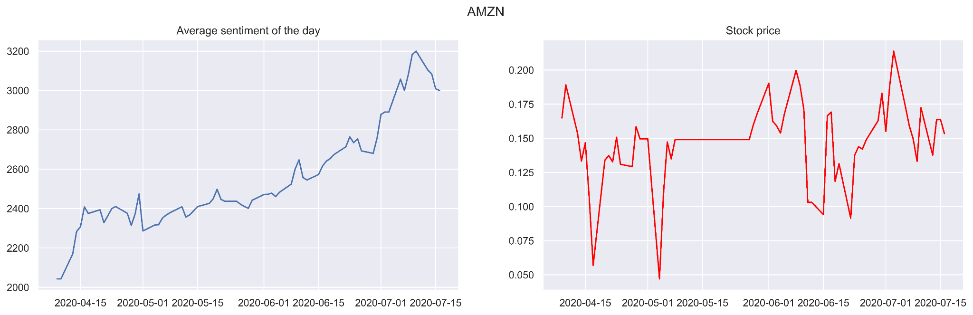
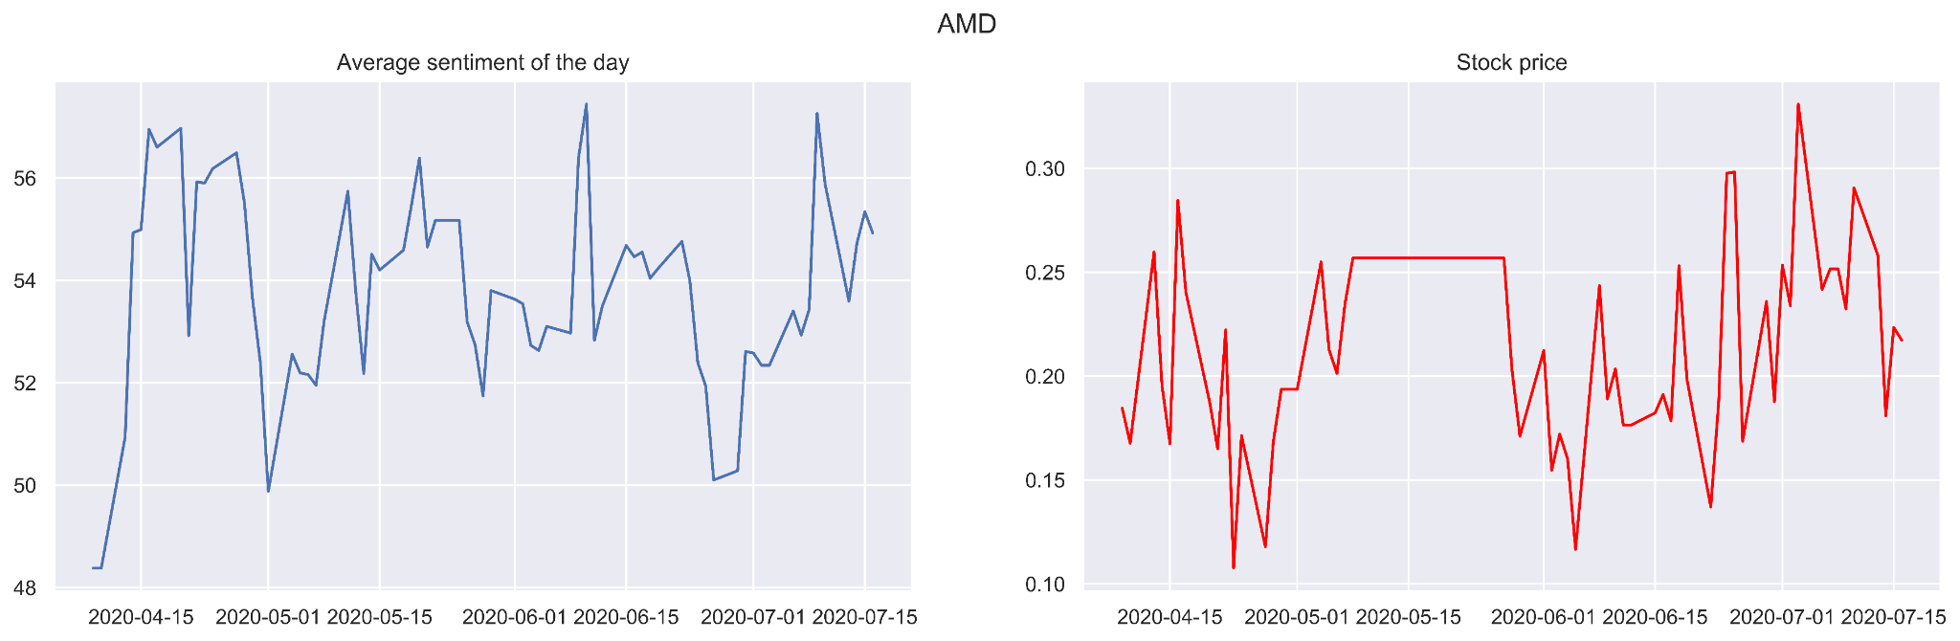
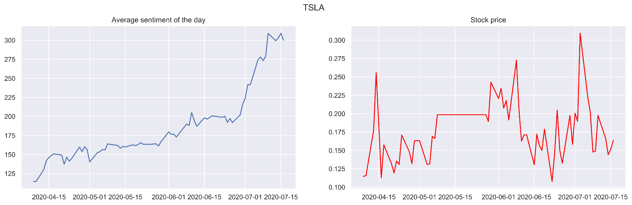
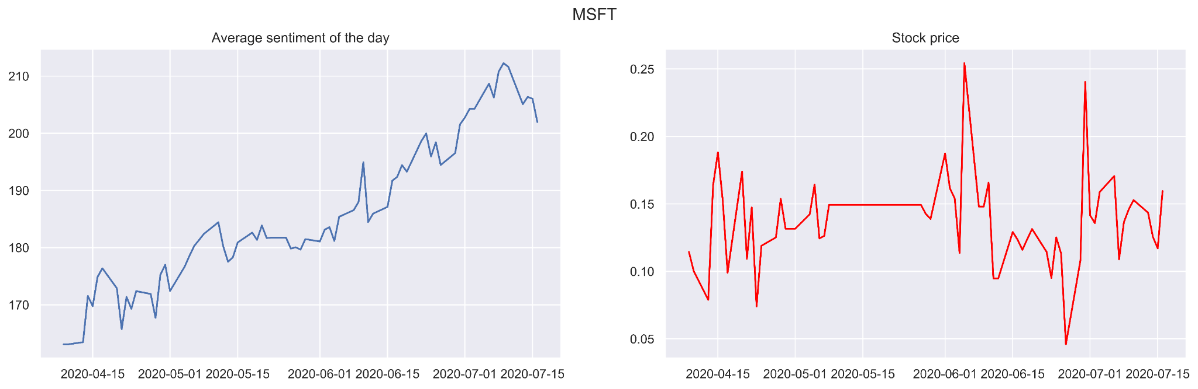
Comparison on Stock Prices and Sentiment Score

Slide 13
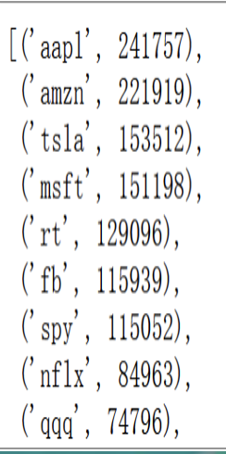
Word Frequency and Word Clouds
Used TweetTokenizer to tokenize tweets
Removed stop words
To Lowercase
Filtered non-alphabetic tokens
Extracted top tokens ranked with respect to frequencies

Slide 14
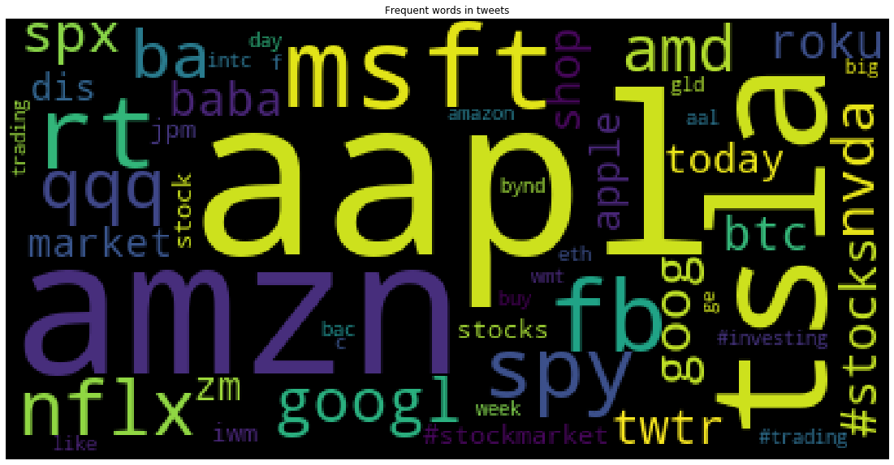
Word Cloud from Tweets

Slide 15
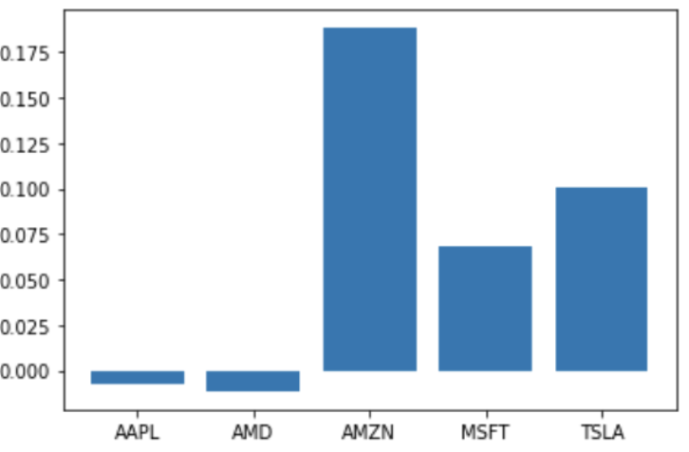
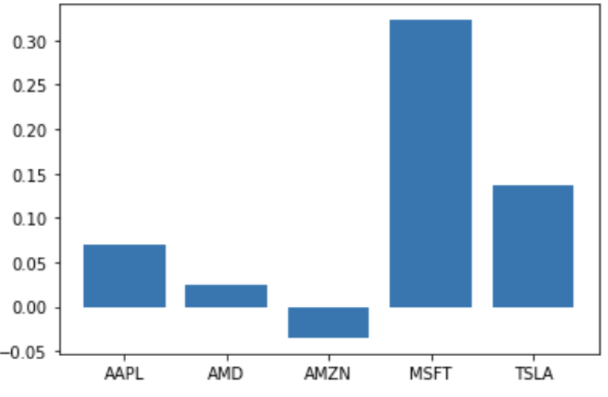
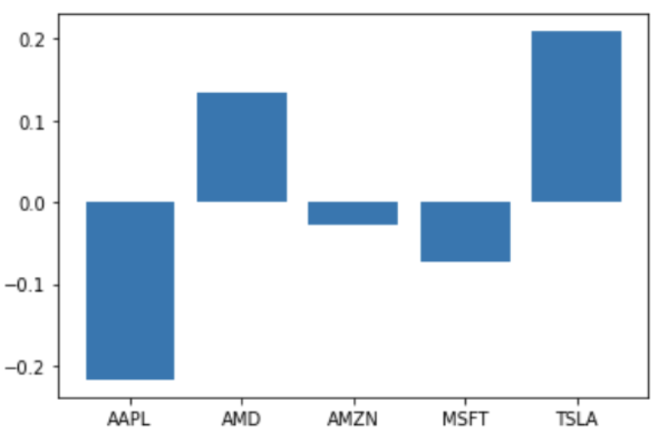
Correlation
Sentiment and Stock Price
Percentage change for both closing price and sentiment score
Considering 1 day lag of percentage change in sentiment with respect to percentage change in price

Slide 16
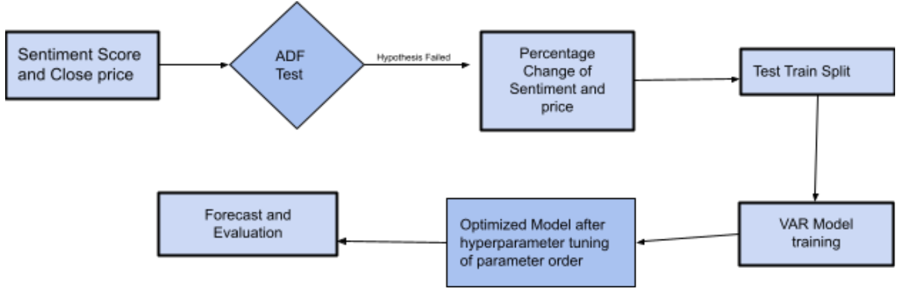
Price Forecasting
Used VAR (Vectorized Auto Regression) model that represents a group of time dependent variables as a linear function of their own past values of all other variables in a group

Slide 17
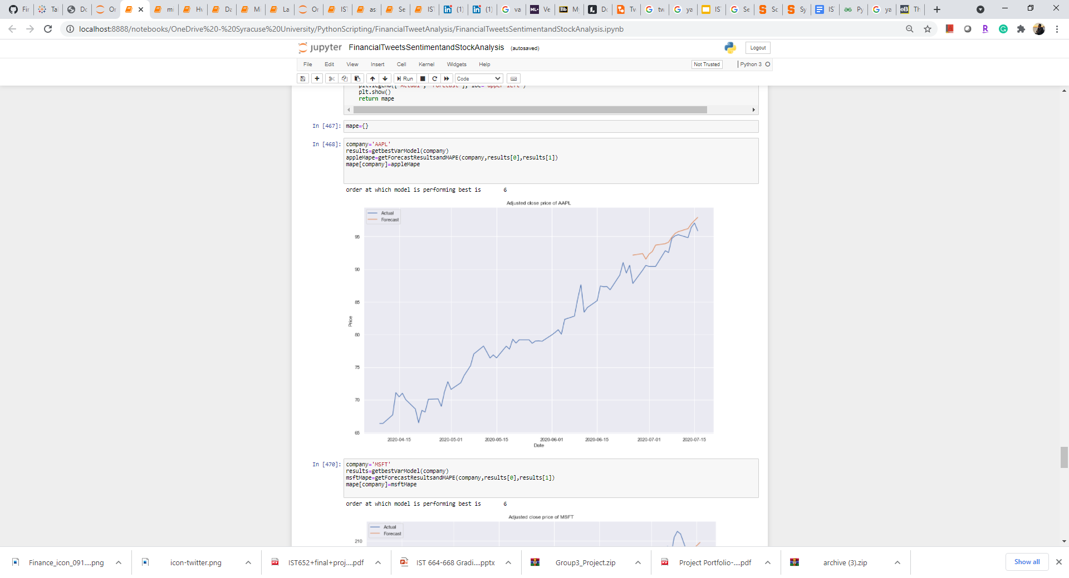
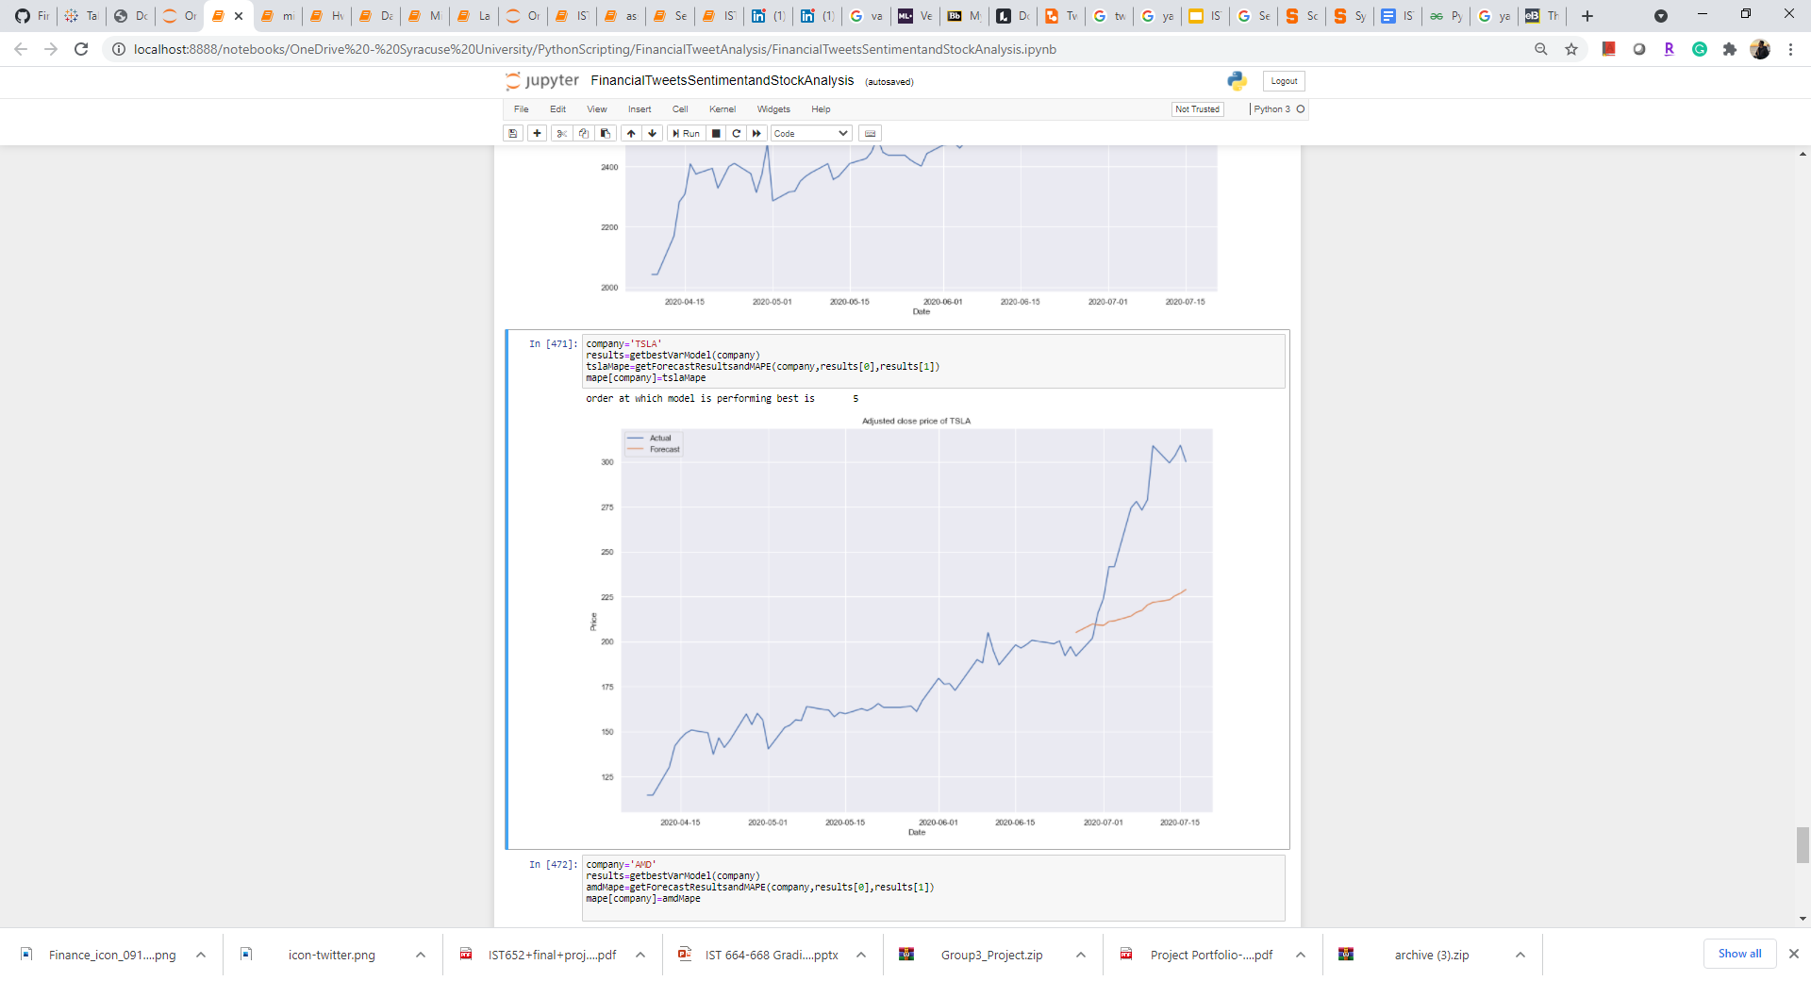
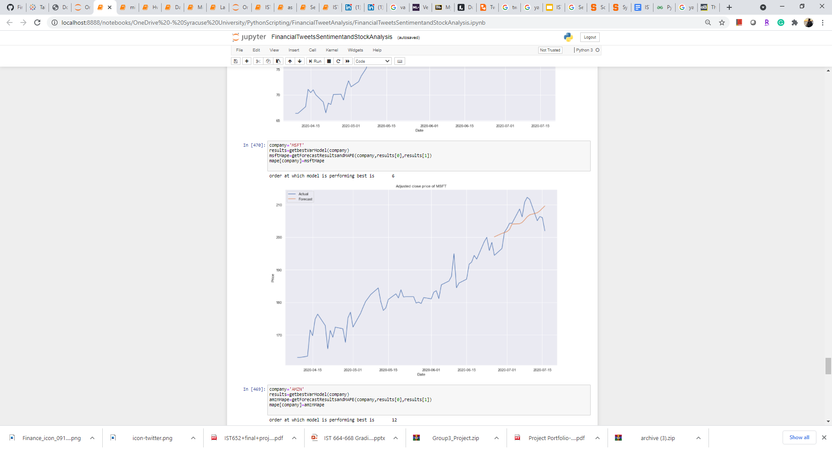
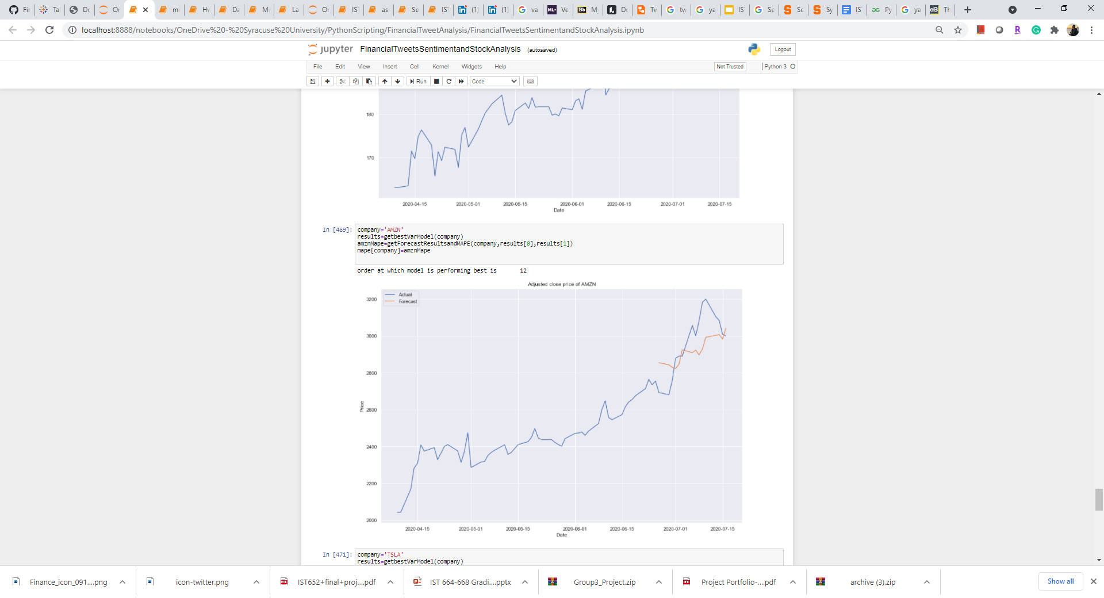
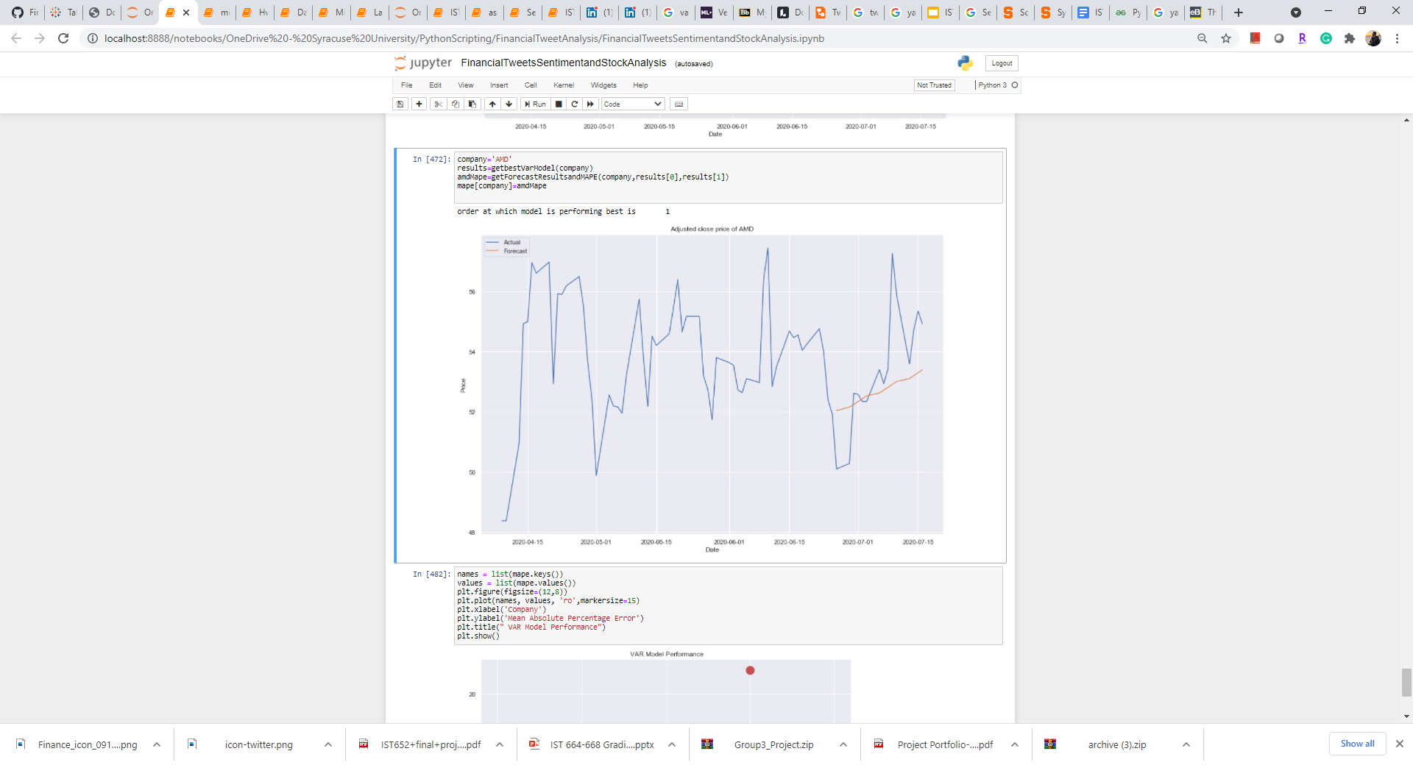
Forecasted Stock Prices
Apple
Tesla
Microsoft
Amazon
AMD

Slide 18
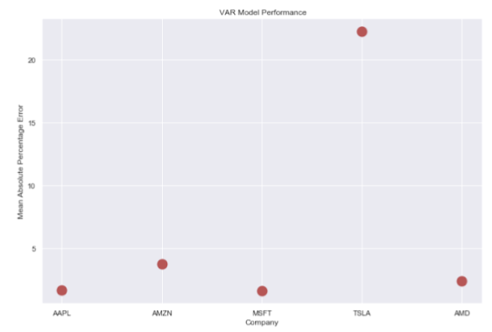
VAR Model Performance

Slide 19
Conclusion
It can be concluded from the results and experiments,
Sentiment analysis on tweets infers low percentage number of negative tweets, i.e., 15%
Stocks of all companies resulted in positive trend which shows rise in stock prices with positive market sentiment
Weak correlation between compound sentiment score and stock prices may be due to non-linearity in compound score
Forecasting with sentiment and stock prices resulted in acceptable error in all the companies except Tesla

Slide 20
References
https://towardsdatascience.com/multivariate-time-series-forecasting-456ace675971
https://www.geeksforgeeks.org/python-sentiment-analysis-using-vader/
https://towardsdatascience.com/a-comprehensive-guide-to-downloading-stock-prices-in-python-2cd93ff821d4
https://einvestingforbeginners.com/stock-correlation-daah/
GitHub Link
https://github.com/lakshyagupta2409/FinancialTweetAnalysis

Slide 21
Thank You!

